Slide 2

1151CS113-COMPUTER GRAPHICS AND IMAGE PROCESSING
SCHOOL OF COMPUTING
DEPARTMENT OF COMPUTER SCIENCE & ENGINEERING
UNIT-5

Slide 3
COMPUTER GRAPHICS AND IMAGE PROCESSING
Course Category: Program Core
Pre-requisite
Link to Other courses
Multimedia Systems
Computer Vision
SL.NO | Course Code | Course Name
1 | 1150MA103 | Engineering Mathematics 2
2 | 1150CS201 | Problem Solving using C

Slide 4
COMPUTER GRAPHICS AND IMAGE PROCESSING
Course Outcomes
CO Nos. | Course Outcomes | Level of learning domain (Based on revised Bloom’s taxonomy)
CO1 | Explain about basics of Computer Graphics | K2
CO2 | Summarize in the Shading models | K2
CO3 | Explain various Advance Modeling Techniques | K2
CO4 | Summarize in Basic of Image Processing | K2
CO5 | Explain various image restoration techniques | K3

Slide 5
COMPUTER GRAPHICS AND IMAGE PROCESSING
UNIT V IMAGE RECONSTRUCTION AND PATTERN ANALYSIS
Restoration, noise removal, clustering. K means, K-metoids, Mixture of gaussian, classification: discriminate function, supervised, un supervised, semi-supervised;classifiers: Bayes, KNN, ANN models.
REFERENCES
www.slideshare.net/.../computer-graphics-image-processing-lecture-n.
Rafael C. Gonzalez and Richard E. Woods, “Digital Image Processing”, Third Edition, Pearson Education, 2008.

Slide 6
Outlines
What is Image Restoration.
Image Enhancement vs. Image Restoration.
Image Degradation Model.
Noise Models.
Estimation of Degradation Model.
Restoration Techniques.
Some Basics Filter
Advanced Image Restoration.
Conclusions.
Tools for DIP.
Applications.

Slide 7
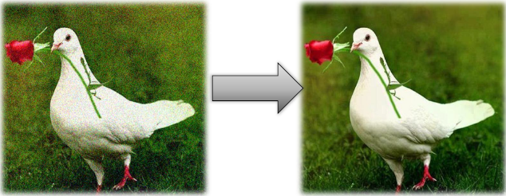
What is Image Restoration.

Slide 8
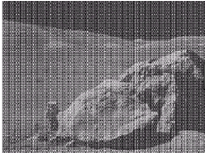
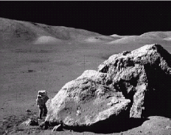
What is Image Restoration?
Image restoration attempts to restore images that have been degraded
Identify the degradation process and attempt to reverse it.
Almost Similar to image enhancement, but more objective.
Fig: Degraded image
Fig: Restored image

Slide 9
Image enhancement vs Image Restoration
Image restoration assumes a degradation model that is known or can be estimated.
Original content and quality does not mean Good looking or appearance.
Image Enhancement is subjective, where as image restoration is objective process.
Image restoration try to recover original image from degraded with prior knowledge of degradation process.
Restoration involves modeling of degradation and applying the inverse process in order to recover the original image.
Although the restore image is not the original image, its approximation of actual image.

Slide 10
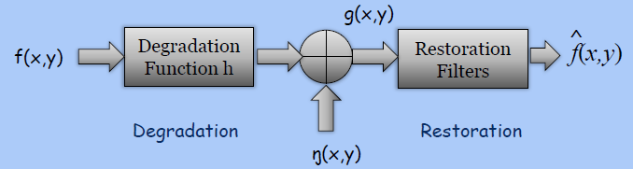
Degradation Model?
Objective: To restore a degraded/distorted image to its original content and quality.
Spatial Domain: g(x,y)=h(x,y)*f(x,y)+ŋ(x,y)
Frequency Domain: G(u,v)=H(u,v)F(u,v)+ ŋ(u,v)
Matrix: G=HF+ŋ
Degradation

Slide 11
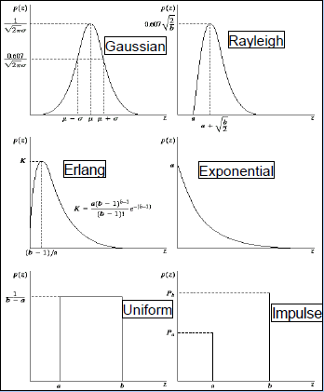
Noise Models and Their PDF
Different models for the image noise term η(x, y)
Gaussian(Most common model)
Rayleigh(non negative)
noise in radar range and velocity images
Erlang or Gamma, Exponential
Noise in laser images
Uniform
Models quantization noise
Salt and pepper noise(Impulse)
Models malfunctioning pixels or timing
errors

Slide 12

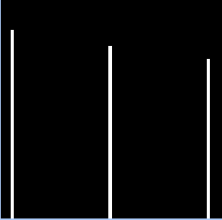
Noise Models Effects
Fig: Original Image
Fig: Original Image histogram

Slide 13
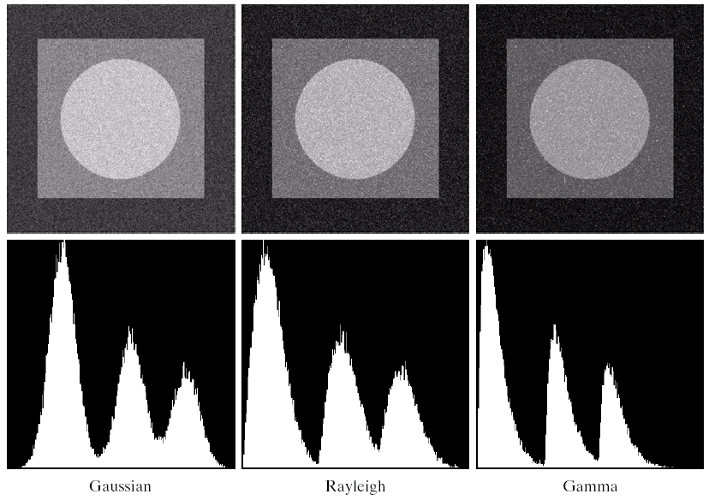
Noise Models Effects contd1…

Slide 14
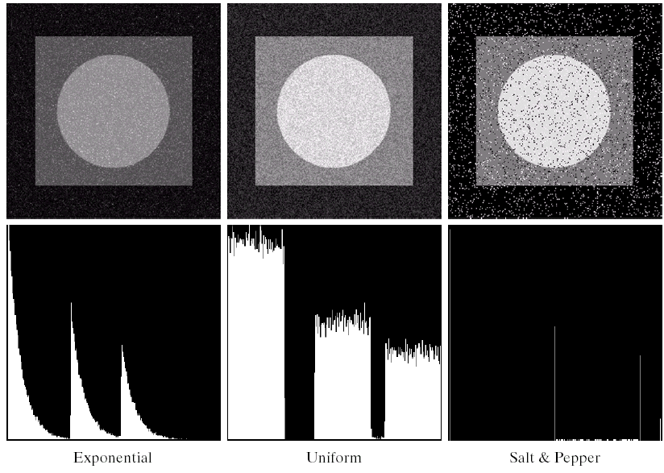
Noise Models Effects contd1…

Slide 15
Estimation of Degradation Model.
Weather the spatial or frequency domain or Matrix, in all cases knowledge of degradation function is important.
Estimation of H is important in image restoration.
There are mainly three ways to estimate the H as follows-
By Observation
By Experimentation.
Mathematical Modeling
After approximation the degradation function, we apply the BLIND CONVOLUTION to restore the original image.

Slide 16
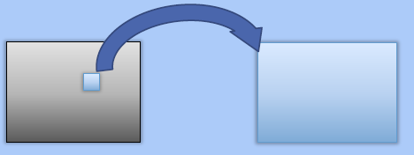
Observation
No knowledge of degraded function is given.
Observing on g(x,y),try to estimate the degraded function in the region which have simpler structure.
gs(x,y) Gs(u,v)
fs(x,y) Fs(u,v)
Hs(u,v)=Gs(u,v)/Fs(u,v)

Slide 17
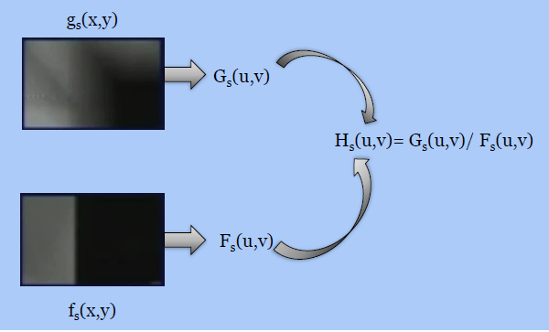
Observation contd…

Slide 18
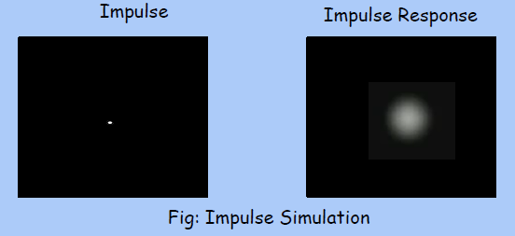
Experimentation
Try to imaging set-up similar to original.
Impulse response and impulse simulation.
Objective to find H which have similar result of degradation as original one.

Slide 19
Experimentation Contd…..
Here f(x,y) is impulse.
F(u,v)=>A (a constant).
G(u,v)=H(u,v)F(u,v).
H(u,v)=G(u,v)/A.
Objective is training and testing.
Never testing on training data.
Note: The intensity of impulse is very high, otherwise noise can dominate to impulse.

Slide 20
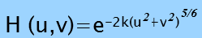
Mathematical Modeling
If you have the mathematical model, you have inside the degradation process.
Atmospheric turbulence can be possible to mapping in mathematical model.
One e.g. of mathematical model
k gives the nature of turbulence.

Slide 21
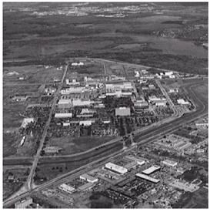
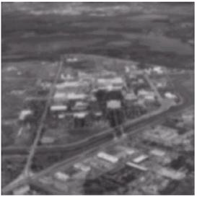
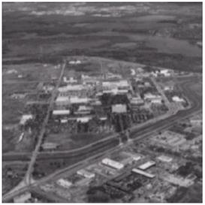
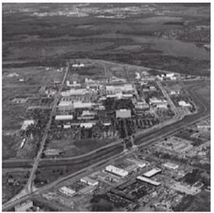
Mathematical Modeling contd..
Atmospheric Turbulence blur examples
Fig: Negligible Turbulence
Fig: Severe Turbulence, k=0.0025
Fig: Mid Turbulence, k=0.001
Fig: Low Turbulence, k=0.00025

Slide 22
Restoration Techniques.
Inverse Filtering.
Minimum Mean Squares Errors.
Weiner Filtering.
Constrained Least Square Filter.
Non linear filtering
Advanced Restoration Technique.

Slide 23
Filter used for Restoration Process
Mean filters
Arithmetic mean filter
Geometric mean filter
Harmonic mean filter
Contra-harmonic mean filter
Order statistics filters
Median filter
Max and min filters
Mid-point filter
alpha-trimmed filters
Adaptive filters
Adaptive local noise reduction filter.
Adaptive median filter

Slide 24
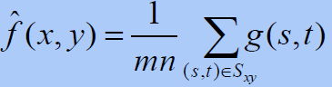
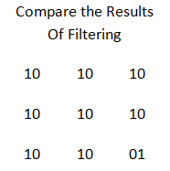
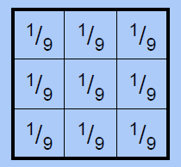
Filtering to Remove Noise-AMF
Use spatial filters of different kinds to remove different kinds of noise
Arithmetic Mean :
This is implemented as the simple smoothing filter Blurs the image to remove noise.

Slide 25
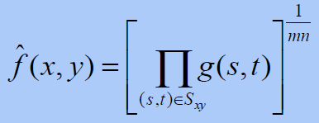
Filtering to Remove Noise-GMF
Geometric Mean:
Achieves similar smoothing to the arithmetic mean, but tends to lose less image detail.

Slide 26
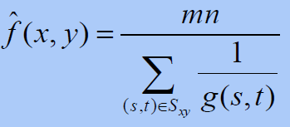
Filtering to Remove Noise-HMF
Harmonic Mean:
Works well for salt noise, but fails for pepper noise
Satisfactory result in other kinds of noise such as Gaussian noise

Slide 27
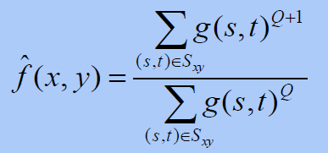
Filtering to Remove Noise-CHMF
Contra-harmonic Mean:
Q is the order of the filter and adjusting its value changes the filter’s behaviour.
Positive values of Q eliminate pepper noise.
Negative values of Q eliminate salt noise.

Slide 28
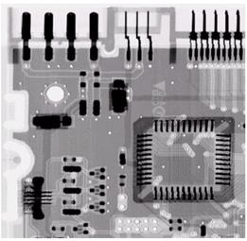
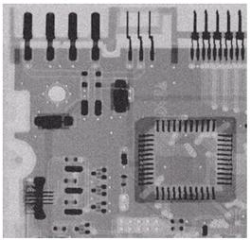
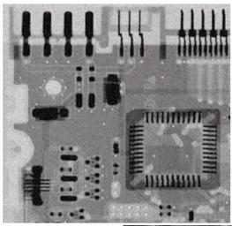
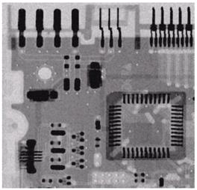
Result of AMF and GMF
Fig: Original Image
Fig: Gaussian Noise
Fig: Result of 3*3 AM
Fig: Result of 3*3 GM

Slide 29
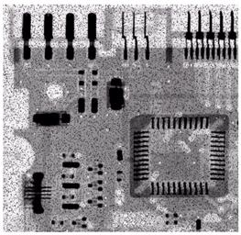
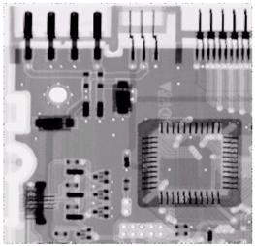
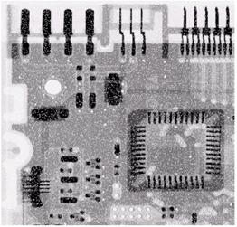
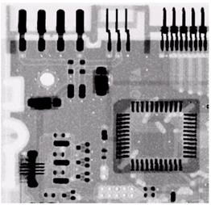
Result of Contra-harmonic Mean Filter
Fig: Original Image with Pepper noise
Fig: After filter by 3*3 CHF, Q=1.5
Fig: Original Image with Salt noise
Fig: After filter by 3*3 CHF, Q=-1.5

Slide 30
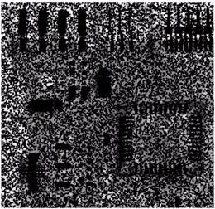
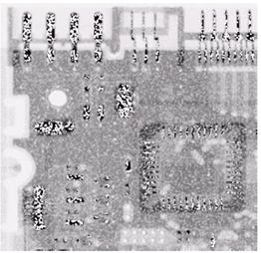
Beware: Q value in Contra-harmonic Filter
Choosing the wrong value for Q when using the contra-harmonic filter can have drastic results.

Slide 31
Order Statistics Filters
Spatial filters that are based on ordering the pixel values that make up the neighborhood operated on by the filter
Useful spatial filters include
Median filter.
Maximum and Minimum filter.
Midpoint filter.
Alpha trimmed mean filter.

Slide 32
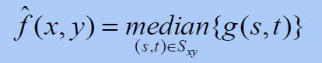
Median Filter
Median Filter:
Excellent at noise removal, without the smoothing effects that can occur with other smoothing filters
Best result for removing salt and pepper noise.

Slide 33
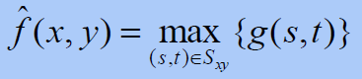
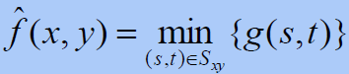
Maximum and Minimum Filter
Max Filter:
Min Filter:
Max filter is good for pepper noise and min is good for salt noise

Slide 34
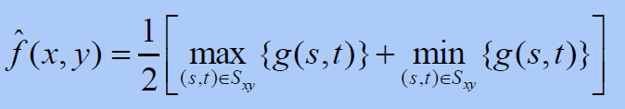
Midpoint Filter
Midpoint Filter
Good for random Gaussian and uniform noise

Slide 35
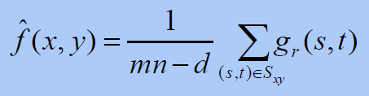
Alpha-Trimmed Mean Filter
Alpha-Trimmed Mean Filter:
Here deleted the d/2 lowest and d/2 highest grey levels, so gr(s, t) represents the remaining mn – d pixels

Slide 36
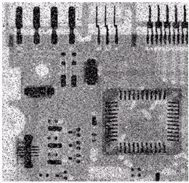
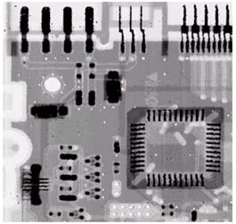
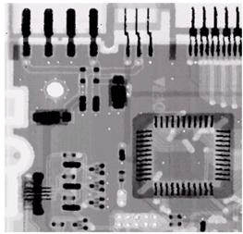
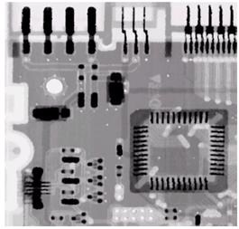
Result of Median Filter
Fig 1: Salt & Pepper noise
Fig2: Result of 1 pass Med 3*3
Fig3: Result of 2 pass Med 3*3
Fig4: Result of 3 pass Med 3*3

Slide 37
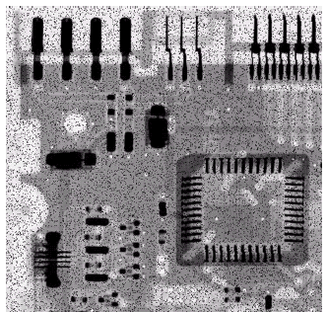
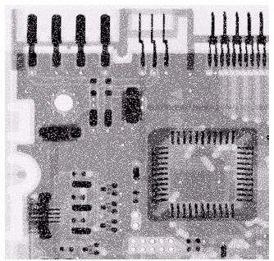
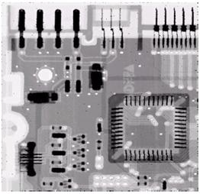
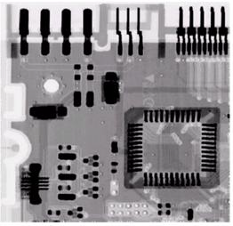
Result of Max and Min Filter
Fig: Corrupted by Pepper Noise
Fig: Corrupted by Salt Noise
Fig: Filtering Above,3*3 Max Filter
Fig: Filtering Above,3*3 Min Filter

Slide 38
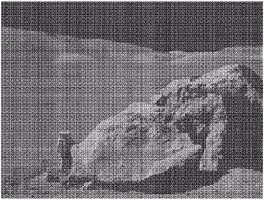
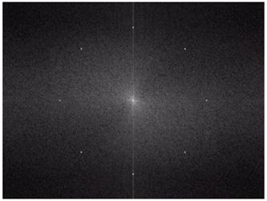
Periodic Noise
Typically arises due to electrical or electromagnetic interference.
Gives rise to regular noise patterns in an image
Frequency domain techniques in the Fourier domain are most effective at removing periodic noise
Fig: periodic Noise

Slide 39
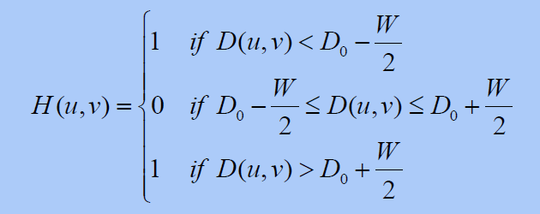
Band Reject Filters
Removing periodic noise form an image involves removing a particular range of frequencies from that image.
Band reject filters can be used for this purpose.
An ideal band reject filter is given as follows:

Slide 40
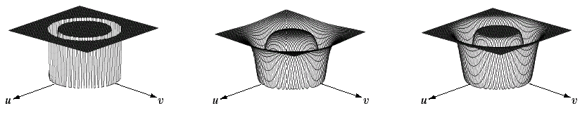
Band Reject Filters contd..
The ideal band reject filter is shown below, along with Butterworth and Gaussian versions of the filter.
Butter worth Band
Reject Filter (of order 1)
Gaussian Band
Reject Filter
Ideal Band Reject Filter

Slide 41
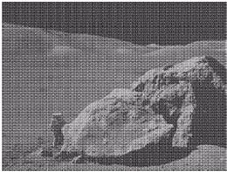



Result of Band Reject Filter
Fig: Corrupted by Sinusoidal Noise
Fig: Fourier spectrum of Corrupted Image
Fig: Butterworth Band Reject Filter
Fig :Filtered image

Slide 42
Advanced Image Restoration
Adaptive Processing
Spatial adaptive
Frequency adaptive
Nonlinear Processing
Thresholding, coring…
Iterative restoration
Advanced Transformation/Modeling
Advanced image transforms, e.g., wavelet…
Statistical image modeling
Blind De blurring or Deconvolution

Slide 43
Clustering
Clustering is the task of dividing the population or data points into a number of groups such that data points in the same groups are more similar to other data points in the same group than those in other groups.
In simple words, the aim is to segregate groups with similar traits and assign them into clusters.
Let’s understand this with an example. Suppose, you are the head of a rental store and wish to understand preferences of your costumers to scale up your business.

Slide 44
Clustering
Let’s understand this with an example. Suppose, you are the head of a rental store and wish to understand preferences of your costumers to scale up your business.
Is it possible for you to look at details of each costumer and devise a unique business strategy for each one of them? Definitely not.
But, what you can do is to cluster all of your costumers into say 10 groups based on their purchasing habits and use a separate strategy for costumers in each of these 10 groups. And this is what we call clustering.

Slide 45
Clustering Applications
Clustering has a large quantity of applications and use-case scenarios, spread across various vertical and horizontal domains. Some examples include
market segmentation,
recommendation systems,
social media analysis,
anomaly detection.

Slide 46
7 examples of clustering algorithms in action.
Identifying Fake News
Spam filter
Marketing and Sales
Classifying network traffic
Identifying fraudulent or criminal activity
Document analysis
Fantasy Football and Sports

Slide 47
Where is clustering used?
Clustering algorithm can be used to monitor the students' academic performance.
Based on the students' score they are grouped into different-different clusters (using k-means, fuzzy c-means etc), where each clusters denoting the different level of performance.

Slide 48
Why Clustering is important in real life?
A clustering algorithm like K-Means Clustering can help you group the data into distinct groups, guaranteeing that the data points in each group are similar to each other.
A good practice in Data Science & Analytics is to first have good understanding of your dataset before doing any analysis

Slide 49
What is the purpose of cluster analysis?
The purpose of cluster analysis is to place objects into groups, or clusters, suggested by the data, not defined a priori, such that objects in a given cluster tend to be similar to each other in some sense, and objects in different clusters tend to be dissimilar.

Slide 50
Types of Clustering
Broadly speaking, clustering can be divided into two subgroups :
Hard Clustering: In hard clustering, each data point either belongs to a cluster completely or not. For example, in the above example each customer is put into one group out of the 10 groups.
Soft Clustering: In soft clustering, instead of putting each data point into a separate cluster, a probability or likelihood of that data point to be in those clusters is assigned. For example, from the above scenario each costumer is assigned a probability to be in either of 10 clusters of the retail store.

Slide 51

Hard and Soft Clustering

Slide 52

Hard and Soft Clustering

Slide 53
Types of clustering algorithms
Since the task of clustering is subjective, the means that can be used for achieving this goal are plenty.
Every methodology follows a different set of rules for defining the ‘similarity’ among data points.
In fact, there are more than 100 clustering algorithms known.
But few of the algorithms are used popularly, let’s look at them in detail:

Slide 54
Connectivity models:
As the name suggests, these models are based on the notion that the data points closer in data space exhibit more similarity to each other than the data points lying farther away.
These models can follow two approaches.
In the first approach, they start with classifying all data points into separate clusters & then aggregating them as the distance decreases.

Slide 55
Connectivity models:
In the second approach, all data points are classified as a single cluster and then partitioned as the distance increases. Also, the choice of distance function is subjective.
These models are very easy to interpret but lacks scalability for handling big datasets.
Examples of these models are hierarchical clustering algorithm and its variants.

Slide 56
Centroid models:
These are iterative clustering algorithms in which the notion of similarity is derived by the closeness of a data point to the centroid of the clusters.
K-Means clustering algorithm is a popular algorithm that falls into this category.
In these models, the no. of clusters required at the end have to be mentioned beforehand, which makes it important to have prior knowledge of the dataset.
These models run iteratively to find the local optima.

Slide 57
Distribution models:
Distribution models:
These clustering models are based on the notion of how probable is it that all data points in the cluster belong to the same distribution
(For example: Normal, Gaussian).
These models often suffer from overfitting.
A popular example of these models is Expectation-maximization algorithm which uses multivariate normal distributions.

Slide 58
Density Models:
Density Models:
These models search the data space for areas of varied density of data points in the data space.
It isolates various different density regions and assign the data points within these regions in the same cluster.
Popular examples of density models are DBSCAN and OPTICS.

Slide 59

K Means Clustering
K means is an iterative clustering algorithm that aims to find local maxima in each iteration. This algorithm works in these 5 steps :
Specify the desired number of clusters K : Let us choose k=2 for these 5 data points in 2-D space.

Slide 60

K Means Clustering
Randomly assign each data point to a cluster : Let’s assign three points in cluster 1 shown using red color and two points in cluster 2 shown using grey color.

Slide 61

K Means Clustering
Compute cluster centroids : The centroid of data points in the red cluster is shown using red cross and those in grey cluster using grey cross.

Slide 62

K Means Clustering
Re-assign each point to the closest cluster centroid : Note that only the data point at the bottom is assigned to the red cluster even though its closer to the centroid of grey cluster. Thus, we assign that data point into grey cluster

Slide 63

K Means Clustering
Re-compute cluster centroids : Now, re-computing the centroids for both the clusters.

Slide 64
K Means Clustering
Repeat steps 4 and 5 until no improvements are possible : Similarly, we’ll repeat the 4th and 5th steps until we’ll reach global optima.
When there will be no further switching of data points between two clusters for two successive repeats.
It will mark the termination of the algorithm if not explicitly mentioned.

Slide 65
Problems on K Means Clustering
Cluster the following eight points (with (x, y)) into three clusters
A1(2,10) A2(2, 5) A3(8, 4) A4(5, 8)
A5(7, 5) A6(6, 4) A7(1, 2) A8(4, 9).
SOLUTION
Here k=3
Initial cluster centres are: A1 (2, 10), A4 (5, 8) and A7 (1, 2).
The distance function between two points (Manhattan distance)
a=(x1, y1) and b=(x2, y2) is defined as:
ρ (a, b) = |x2 – x1| + |y2 – y1|.

Slide 66
Problems on K Means Clustering
Iteration 1
= dist b/w (4, 9) and (2, 10) =| (2-4) + (10-9) =2+1=3
 |  | (2, 10) | (5, 8) | (1, 2)
 | Point | Dist Mean 1 | Dist Mean 2 | Dist Mean 3 | Cluster
A1 | (2, 10) | 0 | 5 | 9 | 1
A2 | (2, 5) | 5 | 6 | 4 | 3
A3 | (8, 4) | 12 | 7 | 9 | 2
A4 | (5, 8) | 5 | 0 | 10 | 2
A5 | (7, 5) | 10 | 5 | 9 | 2
A6 | (6, 4) | 10 | 5 | 7 | 2
A7 | (1, 2) | 9 | 10 | 0 | 3
A8 | (4, 9) | 3 | 2 | 10 | 2

Slide 67
Problems on K Means Clustering
Now the cluster’s are (After 1st Iteration)
Cluster 1 Cluster 2 Cluster 3
(2, 10) (8, 4) (2, 5)
(5, 8) (1, 2)
(7, 5)
(6, 4)
(4, 9)
Clusters: c1: {A1}, C2 :{ A3, A4, A5, A6, A8}, C3: {A2, A7}
Next, we need to re-compute the new cluster centres (means). We do so, by taking the mean of all points in each cluster.

Slide 68
Problems on K Means Clustering
For Cluster 1, we only have one point A1 (2, 10), which was the old mean, so the cluster centre remains the same.
For Cluster 2, we have ((8+5+7+6+4)/5, (4+8+5+4+9)/5) = (6, 6)
For Cluster 3, we have ((2+1)/2, (5+2)/2) = (1.5, 3.5)
Now cluster centres are: A1 (2, 10), A4 (6, 6) and A7 (1.5, 3.5).

Slide 69
Problems on K Means Clustering
Iteration 2
 |  | (2,10) | (6,6) | (1.5,3.5)
 | Point | Dist Mean 1 | Dist Mean 2 | Dist Mean 3 | Cluster
A1 | (2, 10) | 0 | 8 | 7 | 1
A2 | (2, 5) | 5 | 5 | 2 | 3
A3 | (8, 4) | 12 | 4 | 7 | 2
A4 | (5, 8) | 5 | 3 | 8 | 2
A5 | (7, 5) | 10 | 2 | 7 | 2
A6 | (6, 4) | 10 | 2 | 5 | 2
A7 | (1, 2) | 9 | 9 | 2 | 3
A8 | (4, 9) | 3 | 5 | 8 | 1

Slide 70
Problems on K Means Clustering
Now the cluster’s are (After 2nd Iteration)
Cluster 1 Cluster 2 Cluster 3
(2, 10) (8, 4) (2, 5)
(4, 9) (5, 8) (1, 2)
(7, 5)
(6, 4)
Clusters: C1: {A1, A8}, C2:{ A3, A4, A5, A6}, C3: {A2, A7}

Slide 71
Problems on K Means Clustering
Next, we need to re-compute the new cluster centers (means). We do so, by taking the mean of all points in each cluster.
• For Cluster 1, we have ((2+4)/2, (10+9)/2) = (3,9.5)
• For Cluster 2, we have ((8+5+7+6)/4, (4+8+5+4)/4) = (6.5, 5.25)
• For Cluster 3, we have ((2+1)/2, (5+2)/2) = (1.5, 3.5)
• Now cluster centers are A1 (3, 9.5), A4 (6.5, 5.25) and A7 (1.5, 3.5).

Slide 72
Problems on K Means Clustering
Iteration 3
 |  | (3,9.5) | (6.5,5.25) | (1.5,3.5)
 | Point | Dist Mean 1 | Dist Mean 2 | Dist Mean 3 | Cluster
A1 | (2, 10) | 1.5 | 9.25 | 7 | 1
A2 | (2, 5) | 5.5 | 4.75 | 2 | 3
A3 | (8, 4) | 9.5 | 2.75 | 7 | 2
A4 | (5, 8) | 3.5 | 4.25 | 8 | 1
A5 | (7, 5) | 8.5 | .75 | 7 | 2
A6 | (6, 4) | 8.5 | 1.75 | 5.5 | 2
A7 | (1, 2) | 9.5 | 8.75 | 2 | 3
A8 | (4, 9) | 1.5 | 6.25 | 5.5 | 1

Slide 73
Problems on K Means Clustering
Now the cluster’s are (After 3rd Iteration)
Cluster 1 Cluster 2 Cluster 3
(2, 10) (8, 4) (2, 5)
(4, 9) (7, 5) (1, 2)
(5, 8) (6, 4)
Clusters: C1: {A1, A4, And A8}, C2 :{ A3, A5, A6}, C3: {A2, A7}

Slide 74
Problems on K Means Clustering
Next, we need to re-compute the new cluster centers (means). We do so, by taking the mean of all points in each cluster.
• For Cluster 1, we have(( 2+4+5)/3,(10+9+8)/3)=(3.66,9)
• For Cluster 2, we have ( (8+7+6)/3, (4+5+4)/3 ) = (7,4.33)
• For Cluster 3, we have ( (2+1)/2, (5+2)/2 ) = (1.5, 3.5)
• Now cluster centers are: A1 (3.66, 9), A4 (7, 4.33) and A7 (1.5, 3.5).

Slide 75
Problems on K Means Clustering
Iteration 4
 |  | (3.66,9) | (7,4.33) | (1.5,3.5)
 | Point | Dist Mean 1 | Dist Mean 2 | Dist Mean 3 | Cluster
A1 | (2, 10) | 2.66 | 10.67 | 7 | 1
A2 | (2, 5) | 5.66 | 5.66 | 2 | 3
A3 | (8, 4) | 9.34 | 1.33 | 7 | 2
A4 | (5, 8) | 2.34 | 5.66 | 8 | 1
A5 | (7, 5) | 7.34 | .66 | 7 | 2
A6 | (6, 4) | 7.34 | 1.33 | 5.5 | 2
A7 | (1, 2) | 9.66 | 8.33 | 2 | 3
A8 | (4, 9) | 0.34 | 9.66 | 5.5 | 1
The means do not change anymore. Finally we get
Clusters: C1: {A1, A4, and A8}, C2 :{ A3, A5, A6} C3: {A2, A7}

Slide 76

K-Medoids
K-Medoids (also called as Partitioning Around Medoid) algorithm was proposed in 1987 by Kaufman and Rousseeuw.
A medoid can be defined as the point in the cluster, whose dissimilarities with all the other points in the cluster is minimum.
The dissimilarity of the medoid(Ci) and object(Pi) is calculated by using
E = |Pi - Ci|
The cost in K-Medoids algorithm is given as

Slide 77
K-Medoids
Algorithm:
Initialize: select k random points out of the n data points as the medoids.
Associate each data point to the closest medoid by using any common distance metric methods.
While the cost decreases: For each medoid m, for each data o point which is not a medoid: 1. Swap m and o, associate each data point to the closest medoid, recompute the cost. 2. If the total cost is more than that in the previous step, undo the swap.

Slide 78
K-Medoids
STEPS to be followed
We first select the 2 Medoids randomly
We calculate the distance blw the rest of the data points & both Medoids
We calculate the total cost involved in forming the cluster using the medoids
We again choose some other medoids and repeat step1 and step2 if we don't get a better cost we will stop or we can even proceed with other data points and see if we could get a better cluster with better cost
Manhattan Distance
(x1,y1) & (x2,y2)
|x1-x2| +|y1-y2|

Slide 79

K-Medoids(Problem to Solve)
Let’s consider the following example:

Slide 80

K-Medoids(Problem to Solve)
If a graph is drawn using the above data points, we obtain the following:
Step 1: Let the randomly selected 2 medoids, so select k = 2 and let C1 -(4,5) and C2 -(8, 5) are the two medoids.

Slide 81

K-Medoids(Problem to Solve)
Step 2: Calculating cost. The dissimilarity of each non-medoid point with the medoids is calculated and tabulated:
Each point is assigned to the cluster of that medoid whose dissimilarity is less. The points 1, 2, 5 go to cluster C1 and 0, 3, 6, 7, 8 go to cluster C2. The Cost = (3 + 4 + 4) + (3 + 1 + 1 + 2 + 2) = 20

Slide 82

K-Medoids(Problem to Solve)
Step 3: randomly select one non-medoid point and recalculate the cost. Let the randomly selected point be (8, 4). The dissimilarity of each non-medoid point with the medoids – C1 (4, 5) and C2 (8, 4) is calculated and tabulated.

Slide 83
K-Medoids(Problem to Solve)
Each point is assigned to that cluster whose dissimilarity is less. So, the points 1, 2, 5 go to cluster C1 and 0, 3, 6, 7, 8 go to cluster C2. The New cost = (3 + 4 + 4) + (2 + 2 + 1 + 3 + 3) = 22 Swap Cost = New Cost – Previous Cost = 22 – 20 and 2 >0
As the swap cost is not less than zero, we undo the swap. Hence (3, 4) and (7, 4) are the final medoids. The clustering would be in the following way

Slide 84


K-Medoids(Problem to Solve)
The time complexity is .

Slide 85
K-Medoids
Advantages:
It is simple to understand and easy to implement.
K-Medoid Algorithm is fast and converges in a fixed number of steps.
PAM is less sensitive to outliers than other partitioning algorithms.
Disadvantages:
The main disadvantage of K-Medoid algorithms is that it is not suitable for clustering non-spherical (arbitrary shaped) groups of objects. This is because it relies on minimizing the distances between the non-medoid objects and the medoid (the cluster centre) – briefly, it uses compactness as clustering criteria instead of connectivity.
It may obtain different results for different runs on the same dataset because the first k medoids are chosen randomly.

Slide 86
K-Medoids
Applications:
Topic Modeling
Author detection
Genre detection
Lyric Generation
Lyric Clustering

Slide 87

KNN algorithm
What is KNN Algorithm?
“K Nearest Neighbour is a simple algorithm that stores all the available cases and classifies the new data or case based on the similarity measure”.
What is K in KNN Algorithm?
K=Number of Nearest Neighbour

Slide 88

KNN algorithm

Slide 89
KNN algorithm
When do we use KNN algorithm?
KNN can be used for both classification and regression predictive problems. However, it is more widely used in classification problems in the industry. To evaluate any technique we generally look at 3 important aspects:
1. Ease to interpret output
2. Calculation time
3. Predictive Power

Slide 90

KNN algorithm
Let us take a few examples to place KNN in the scale :
KNN algorithm fairs across all parameters of considerations. It is commonly used for its easy of interpretation and low calculation time.

Slide 91

How does the KNN algorithm work?
Let’s take a simple case to understand this algorithm. Following is a spread of red circles (RC) and green squares (GS) :

Slide 92

How does the KNN algorithm work?
You intend to find out the class of the blue star (BS). BS can either be RC or GS and nothing else. The “K” is KNN algorithm is the nearest neighbor we wish to take the vote from. Let’s say K = 3.
Hence, we will now make a circle with BS as the center just as big as to enclose only three data points on the plane. Refer to the following diagram for more details:

Slide 93
How does the KNN algorithm work?
The three closest points to BS is all RC. Hence, with a good confidence level, we can say that the BS should belong to the class RC.
Here, the choice became very obvious as all three votes from the closest neighbor went to RC. The choice of the parameter K is very crucial in this algorithm.
Next, we will understand what are the factors to be considered to conclude the best K.

Slide 94
How do we choose the factor K?
First let us try to understand what exactly does K influence in the algorithm.
If we see the last example, given that all the 6 training observation remain constant, with a given K value we can make boundaries of each class.
These boundaries will segregate RC from GS. In the same way, let’s try to see the effect of value “K” on the class boundaries.
The following are the different boundaries separating the two classes with different values of K.

Slide 95
How do we choose the factor K?

Slide 96

How do we choose the factor K?
If you watch carefully, you can see that the boundary becomes smoother with increasing value of K. With K increasing to infinity it finally becomes all blue or all red depending on the total majority. The training error rate and the validation error rate are two parameters we need to access different K-value. Following is the curve for the training error rate with a varying value of K :

Slide 97

How do we choose the factor K?
As you can see, the error rate at K=1 is always zero for the training sample. This is because the closest point to any training data point is itself. Hence the prediction is always accurate with K=1. If validation error curve would have been similar, our choice of K would have been 1. Following is the validation error curve with varying value of K:

Slide 98
How do we choose the factor K?
This makes the story more clear. At K=1, we were overfitting the boundaries. Hence, error rate initially decreases and reaches a minima.
After the minima point, it then increase with increasing K. To get the optimal value of K, you can segregate the training and validation from the initial dataset.
Now plot the validation error curve to get the optimal value of K. This value of K should be used for all predictions.

Slide 99


How things are predicted in KNN Algo?
0 1 2 3 4 5
0
1
2
3
4
5
Point P1=(1,1)
Point P2=(5,4)

Slide 100
Pseudo Code of KNN
We can implement a KNN model by following the below steps:
Load the data
Initialise the value of k
For getting the predicted class, iterate from 1 to total number of training data points
Calculate the distance between test data and each row of training data. Here we will use Euclidean distance as our distance metric since it’s the most popular method. The other metrics that can be used are Chebyshev, cosine, etc.
Sort the calculated distances in ascending order based on distance values
Get top k rows from the sorted array
Get the most frequent class of these rows
Return the predicted class

Slide 101
Problem based on KNN algorithm
Using KNN algorithm, Let say we have a document classification task. Let a document d5(3,7) needs to be assigned a class are four training documents belonging to ‘c1’&’c2’
D1 | 7 | 7
D2 | 7 | 4
D3 | 3 | 4
D4 | 1 | 4
D5 | 3 | 7

Slide 102
Problem based on KNN algorithm
Let say how to classify the datapoint a new point using KNN and regression task for the following scenario given. Let us take we have to eight persons among that eight person only seven persons age and weight is given and for eighth person age is given we have to find the weight.
S.NO | HEIGHT | AGE | WEIGHT
P1 | 6 | 40 | 60
P2 | 6.11 | 26 | 55
P3 | 5.9 | 30 | 56
P4 | 5.8 | 32 | 58
P5 | 5.3 | 33 | 75
P6 | 5.6 | 34 | 78
P7 | 5.5 | 35 | 80
P8 | 58 | 37 | ?

Slide 103
What is an Artificial Neural Network?
Artificial Neural Networks are the computational models that are inspired by the human brain. Many of the recent advancements have been made in the field of Artificial Intelligence, including Voice Recognition, Image Recognition, Robotics using Artificial Neural Networks. Artificial Neural Networks are the biologically inspired simulations performed on the computer to perform certain specific tasks like –
Clustering
Classification
Pattern Recognition

Slide 104
Artificial Neural Networks
Artificial Neural Networks, in general – is a biologically inspired network of artificial neurons configured to perform specific tasks.
These biological methods of computing are considered to be the next major advancement in the Computing Industry.
What is a Neural Network?
The term ‘Neural’ is derived from the human (animal) nervous system’s basic functional unit ‘neuron’ or nerve cells that are present in the brain and other parts of the human (animal) body. A neural network is a group of algorithms that certify the underlying relationship in a set of data similar to the human brain. The neural network helps to change the input so that the network gives the best result without redesigning the output procedure. You can also learn more about ONNX in this insight.

Slide 105
ANN & BNN
Artificial Neural Networks (ANN) & Biological Neural Networks (BNN) – Difference
Characteristics | Artificial Neural Network | Biological(Real) Neural Network
Speed | Faster in processing information. Response time is in nanoseconds. | Slower in processing information. The response time is in milliseconds.
Processing | Serial processing. | Massively parallel processing.
Size & Complexity | Less size & complexity. It does not perform complex pattern recognition tasks. | Highly complex and dense network of interconnected neurons containing neurons of the order of 1011 with 1015 of interconnections.<strong

Slide 106
ANN & BNN
Characteristics | Artificial Neural Network | Biological(Real) Neural Network
Storage | Information storage is replaceable means new data can be added by deleting an old one. | Information storage is adaptable means new information is added by adjusting the interconnection strengths without destroying old information
Fault tolerance | Fault intolerant. Information once corrupted cannot be retrieved in case of failure of the system.
Control Mechanism | There is a control unit for controlling computing activities | No specific control mechanism external to the computing task.

Slide 107
Artificial Neural Networks
Artificial Neural Networks are used to process the information the way biological systems process analog signals like image and sound.
Types of ANN
Feed forward networks
Information only flows one way
One input pattern produces one output
No sense of time (or memory of previous state)
Recurrency
Nodes connect back to other nodes or Themselves
Information flow is multidirectional
Sense of time and memory of previous state(s)

Slide 108
How Artificial Neural Networks Works?
Firstly, it helps us understand the impact of increasing / decreasing the dataset vertically or horizontally on computational time.
Secondly, it helps us understand the situations or cases where the model fits best.
Thirdly, it also helps us explain why certain model works better in certain environment or situations.

Slide 109

Formulation of Neural network
We will start with understanding formulation of a simple hidden layer neural network. A simple neural network can be represented as shown in the figure below:

Slide 110
Formulation of Neural network
The linkages between nodes are the most crucial finding in an ANN. We will get back to “how to find the weight of each linkage” after discussing the broad framework.
The only known values in the above diagram are the inputs. Lets call the inputs as I1, I2 and I3, Hidden states as H1,H2.H3 and H4, Outputs as O1 and O2.
The weights of the linkages can be denoted with following notation:
W(I1H1) is the weight of linkage between I1 and H1 nodes.

Slide 111

Framework in which ANN work:
Following is the framework in which artificial neural networks (ANN) work:

Slide 112

Few statistical details about the framework
Every linkage calculation in an Artificial Neural Network (ANN) is similar. In general, we assume a sigmoid relationship between the input variables and the activation rate of hidden nodes or between the hidden nodes and the activation rate of output nodes. Let’s prepare the equation to find activation rate of H1.
Logit (H1) = W(I1H1) * I1 + W(I2H1) * I2 + W(I3H1) * I3 + Constant = f
= > P(H1) = 1/(1+e^(-f))
Following is how the sigmoid relationship looks like :

Slide 113

Artificial Neuron System
Input layer
Hidden layer
Output layer

Slide 114

Block Diagram off Neural Architecture

Slide 115
Advantages
A neural network can perform tasks that a linear program cannot.
When an element of the neural network fails, it can continue without any problem by their parallel nature.
A neural network learns and does not need to be reprogrammed.
It works even in the presence of noise with good quality output.

Slide 116
Disadvantages
The neural network needs training to operate.
The architecture of a neural network is different from the architecture of
microprocessors therefore needs to be emulated.
Requires high processing time for large neural networks.
As the number of neurons increases the network becomes complex.

Slide 117
Applications
Pattern Matching
Pattern Recognition
Optimization
Vector Quantization
Data Clustering

Slide 118

Mixture of Gaussian
Gaussian Mixture is a function that includes multiple Gaussians equal to the total number of clusters formed. Each Gaussian in the mixture carries some parameters which are:
A mean, that defines the center.
A covariance, that defines the width.
A probability.

Slide 119

Mixture of Gaussian
Gaussian Mixture is a function that includes multiple Gaussians equal to the total number of clusters formed. Each Gaussian in the mixture carries some parameters which are:
A mean, that defines the center.
A covariance, that defines the width.
A probability.
There are three clusters that mean three Gaussian functions.
Each Gaussian explains the data present in each of the clusters available.

Slide 120
Mixture of Gaussian
Since there are three( k=3) clusters and the probability density is defined as a linear function of densities of all these k distributions.
Here it is assumed that there are total N number of samples and each sample containing dfeatures are denoted by xi
So it can be clearly seen that the parameters cannot be estimated in closed form. This is where Expectation Maximization algorithm is beneficial.

Slide 121


Mixture of Gaussian

Slide 122

Mixture of Gaussian

Slide 123

Mixture of Gaussian

Slide 124

Classification: Discriminate Function
Classification is a process related to categorization, the process in which ideas and objects are recognized, differentiated and understood

Slide 125
Supervised
Supervised classification is based on the idea that a user can select sample pixels in an image that are representative of specific classes and then direct the image processing software to use these training sites as references for the classification of all other pixels in the image.
Training sites (also known as testing sets or input classes) are selected based on the knowledge of the user. The user also sets the bounds for how similar other pixels must be to group them together.

Slide 126
Supervised
These bounds are often set based on the spectral characteristics of the training area, plus or minus a certain increment (often based on “brightness” or strength of reflection in specific spectral bands).
The user also designates the number of classes that the image is classified into. Many analysts use a combination of supervised and unsupervised classification processes to develop final output analysis and classified maps.

Slide 127

Supervised

Slide 128
Unsupervised
Unsupervised classification is where the outcomes (groupings of pixels with common characteristics) are based on the software analysis of an image without the user providing sample classes.
The computer uses techniques to determine which pixels are related and groups them into classes.
The user can specify which algorism the software will use and the desired number of output classes but otherwise does not aid in the classification process.
However, the user must have knowledge of the area being classified when the groupings of pixels with common characteristics produced by the computer have to be related to actual features on the ground (such as wetlands, developed areas, coniferous forests, etc.).

Slide 129

Semi - Supervised
Semi-supervised learning is an approach to machine learning that combines a small amount of labeled data with a large amount of unlabeled data during training.
Semi-supervised learning falls between unsupervised learning (with no labeled training data) and supervised learning (with only labeled training data).

Slide 130
Classification: Discriminate Function
Discriminant analysis is a classification method. It assumes that different classes generate data based on different Gaussian distributions.
To train a classifier, the fitting function estimates the parameters of a Gaussian distribution for each class
To predict the classes of new data, the trained classifier finds the class with the smallest misclassification cost
Linear discriminant analysis is also known as the Fisher discriminant, named for its inventor, Sir R. A. Fisher.

Slide 131
Classifiers: Bayes
A Bayesian classifier is based on the idea that the role of a (natural) class is to predict the values of features for members of that class.
Examples are grouped in classes because they have common values for the features. Such classes are often called natural kinds.
In this section, the target feature corresponds to a discrete class, which is not necessarily binary.
The idea behind a Bayesian classifier is that, if an agent knows the class, it can predict the values of the other features. If it does not know the class, Bayes' rule can be used to predict the class given (some of) the feature values.

Slide 132


Classifiers: Bayes
A Bayesian classifier is a probabilistic model where the classification is a latent variable that is probabilistically related to the observed variables. Classification then become inference in the probabilistic model.
Bayes's theorem is stated mathematically as the following equation:

Slide 133
Classifiers: Bayes
Suppose, a particular test for whether someone has been using cannabis is 90% sensitive, meaning the true positive (TPR)=0.90.
Therefore it leads to 90% true positive results (correct identification of drug use) for cannabis users.
The test is also 80% specific, meaning true negative rate (TNR)=0.80. Therefore the test correctly identifies 80% of non-use for non-users, but also generates 20% false positives, or false positive rate (FPR)=0.20, for non-users.
Assuming 0.05 prevalence , meaning 5% of people use cannabis, what is the probability that a random person who tests positive is really a cannabis user?

Slide 134

Classifiers: Bayes
The Positive Predictive value (PPV) of a test is proportion of persons who are actually positive out of all those testing positive, and can be calculated from a sample as:
PPV = True positive / Tested positive
If sensitivity, specificity, and prevalence are known, PPV can be calculated using Bayes theorem.
Let mean "the probability that someone is a cannabis user given that they test positive," which is what is meant by PPV.
We can write:

Slide 135
Classifiers: Bayes
The fact that is a direct application of the Law of Total Probability.
In this case, it says that the probability that someone tests positive is the probability that a user tests positive, times the probability of being a user, plus the probability that a non-user tests positive, times the probability of being a non-user.
This is true because the classifications user and non-user form a partition of a set, namely the set of people who take the drug test.
This combined with the definition of conditional probability results in the above statement.

Slide 136
Classifiers: Bayes
Even if someone tests positive, the probability they are a cannabis user is only 19%, because in this group only 5% of people are users, most positives are false positives coming from the remaining 95%.
If 1,000 people were tested:
950 are non-users and 190 of them give false positive (0.20 × 950) 50 of them are users and 45 of them give true positive (0.90 × 50)
The 1,000 people thus yields 235 positive tests, of which only 45 are genuine drug users, about 19%.

Slide 137
Classifiers: ANN models
Artificial neural networks (ANNs), usually simply called neural networks (NNs), are computing systems vaguely inspired by the biological neural networks that constitute animal brains.
An ANN is based on a collection of connected units or nodes called artificial neurons, which loosely model the neurons in a biological brain.
Each connection, like the synapses in a biological brain, can transmit a signal to other neurons.
An artificial neuron that receives a signal then processes it and can signal neurons connected to it.
The "signal" at a connection is a real number, and the output of each neuron is computed by some non-linear function of the sum of its inputs
The connections are called edges.

Slide 138

Classifiers: ANN models

Slide 139
References
Fredrick M Weinhaus, Venkat Devarajan,Texture mapping 3D models of real-world scenes .ACM computing survey , Volume 29 1997.
James F. Blinn and Martin E. Newel,Texture and Reflection in computer generated images. ACM computing survey.
https://99designs.com/blog/tips/correct-file-formats-rgb-and-cmyk/
https://www.ft.unicamp.br/docentes/magic/khoros/html-dip/c2/s7/front-page.html
https://bohr.wlu.ca/hfan/cp467/12/notes/cp467_12_lecture12_color.pdf
https://www.cs.nmt.edu/~ip/lectures.html
https://perso.esiee.fr/~coustyj/EnglishMorphoGraph/L10.pdf
https://programmingdesignsystems.com/color/color-models-and-color-spaces/index.html

